Slide 1
Proof Capped Bust Quarters
By Joey Lamonte

Slide 2
Is the coin we are studying ?
A Proof
One-sided Proof
A Specimen
Or Proof-like

Slide 3
Proof coins
Specially made coins for dignitaries, presentation and collectors.
Struck on specially prepared planchets specially prepared dies
Method of manufacture, not a grade.
Carefully struck twice or occasionally three or more times
Early Proofs may show weakness in detail

Slide 4
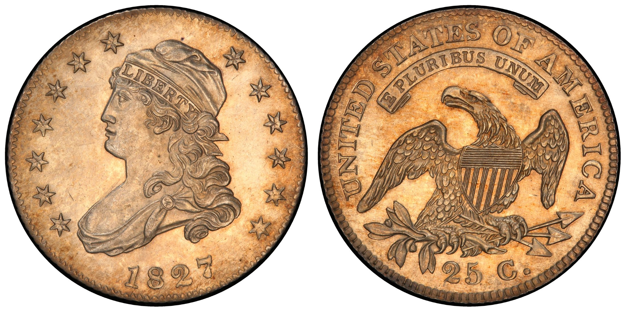
A Proof
1827 B-1
PCGS Proof 64
Parmelee/
James A. Stack

Slide 5
One-sided proofs
Struck with only the obverse die polished to Proof quality.
And only the obverse planchet is fully polished.

Slide 6
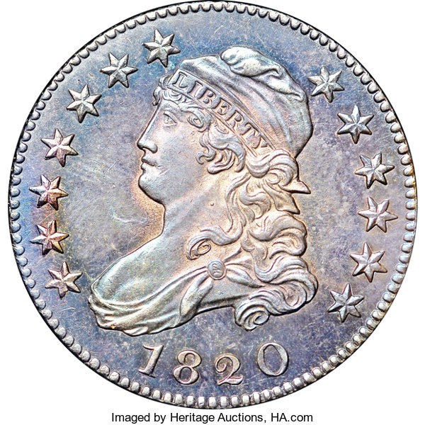
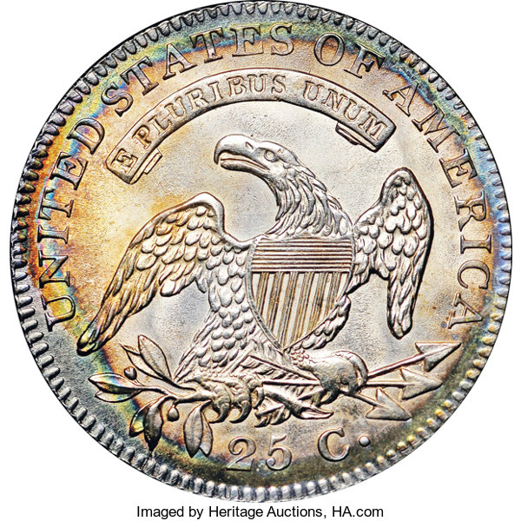
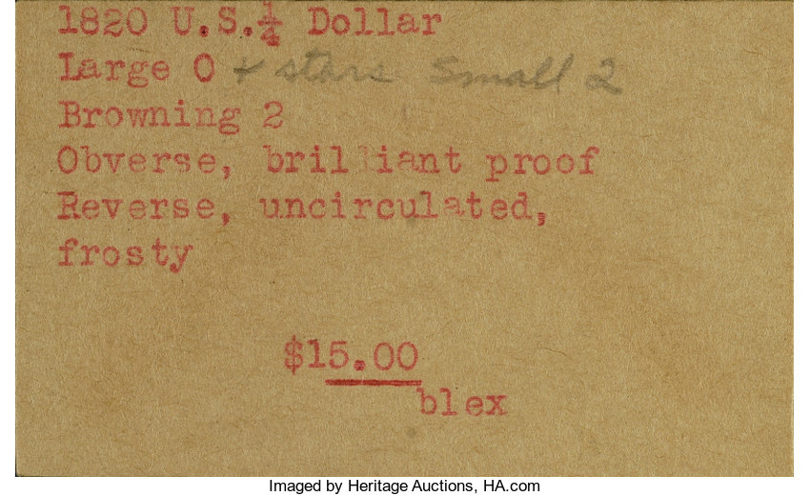
One sided proof
1820 B-2

Slide 7
specimens
Used for coins dated from 1792-1817
Share many characteristics of the later Proof coinage.
Appear to have been specially made…
…but lack the qualities to be clearly designated as a Proof.

Slide 8
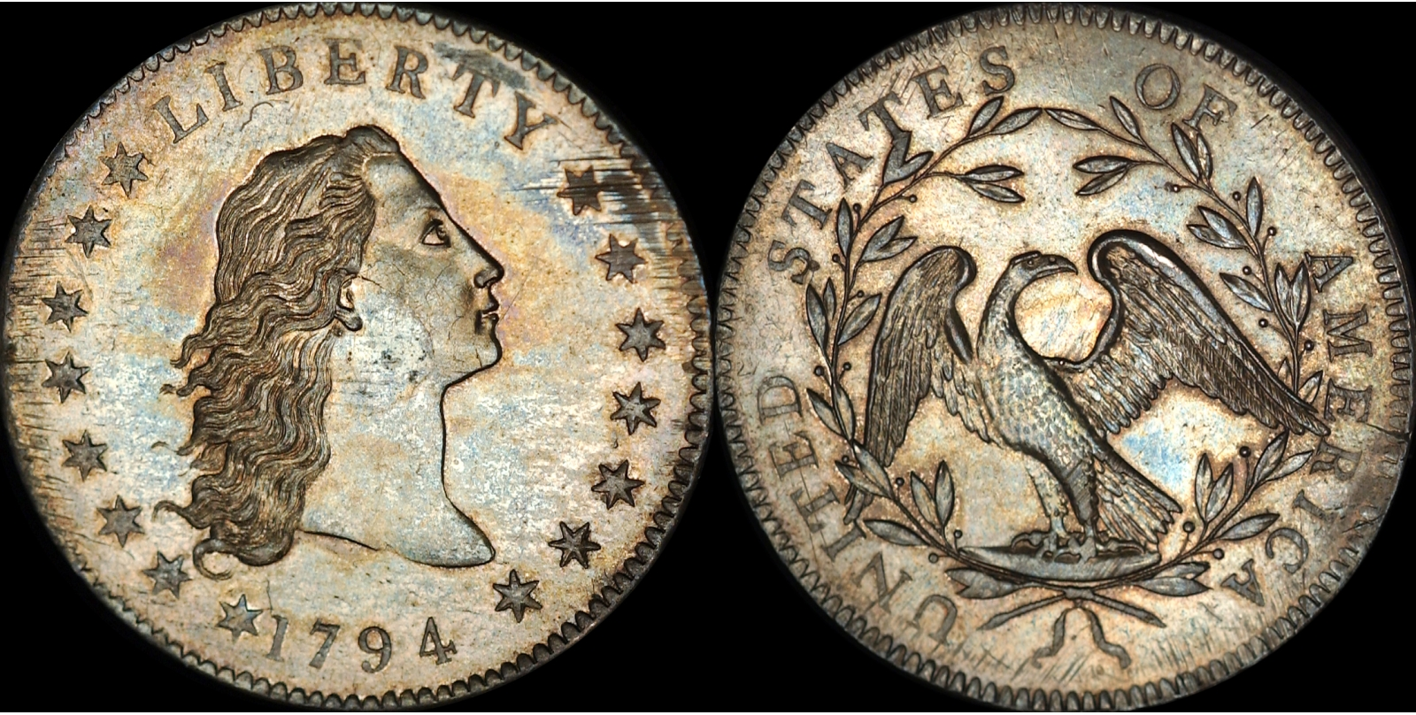
specimen
The Specimen 66 1794 Silver Dollar is a good example of a $10,000,000 Specimen.
At the present time no Draped Bust or Capped Bust Quarters have been called Specimen at either PCGS or NGC.

Slide 9
1796 Specimen 63
O-101 R-8

Slide 10
Proof-like
Used to designate coins with mirror-like surfaces.
Usually the very earliest strikes from new dies
Can be struck from previously polished Proof dies.

Slide 11
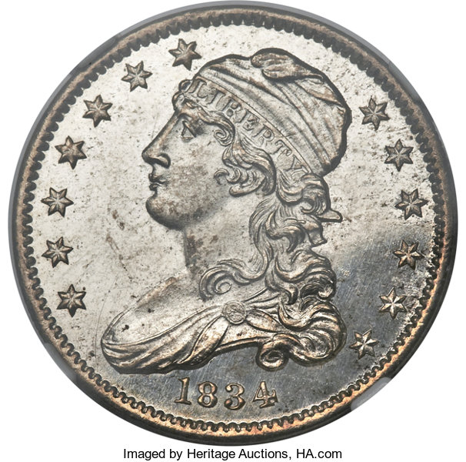
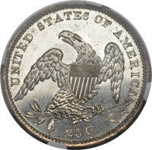
Proof-like
1834 B-1
NGC MS66*
Proof-Like

Slide 12
Walter Breen
A Proof should look much better than a regular strike from the same dies.
A Proof should be struck on polished planchets, polished dies or both.
Mirror brilliance should be apparent in the fields and around the devices and letters.
Brilliance should be present in the vertical shield lines.

Slide 13
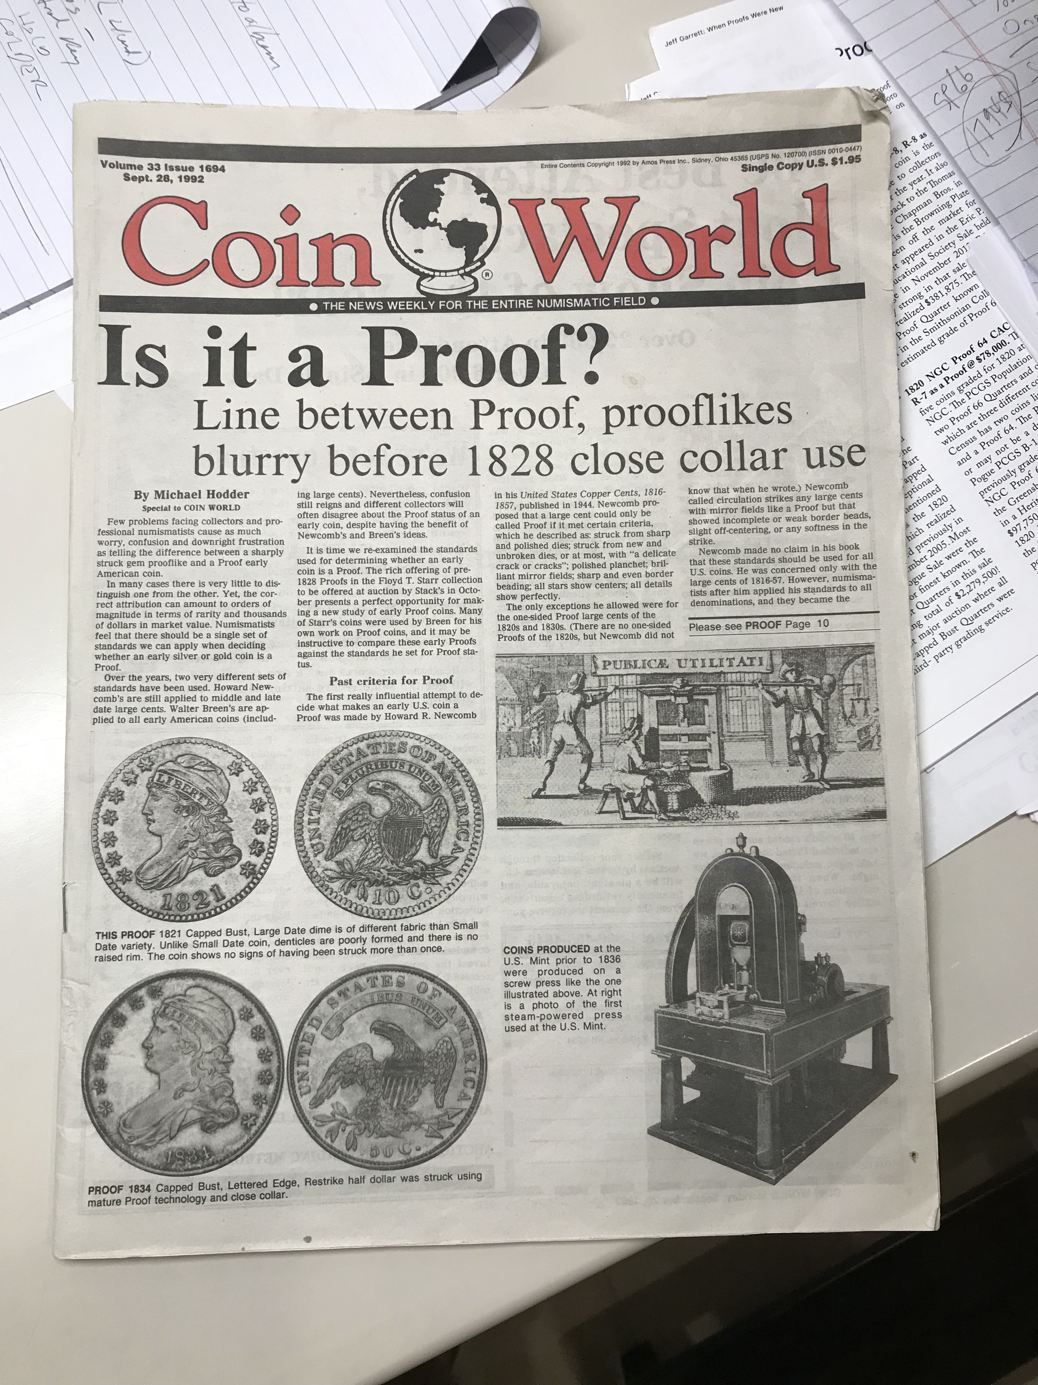
Michael hodder
In a Coin World article in September 1992 Michael Hodder wrote:
“The best single test of an early Proof is to compare it to a known business strike of the same date and dies.
A Proof is intended to represent the highest quality of coinage possible at the time. If it looks entirely different, it is.”

Slide 14
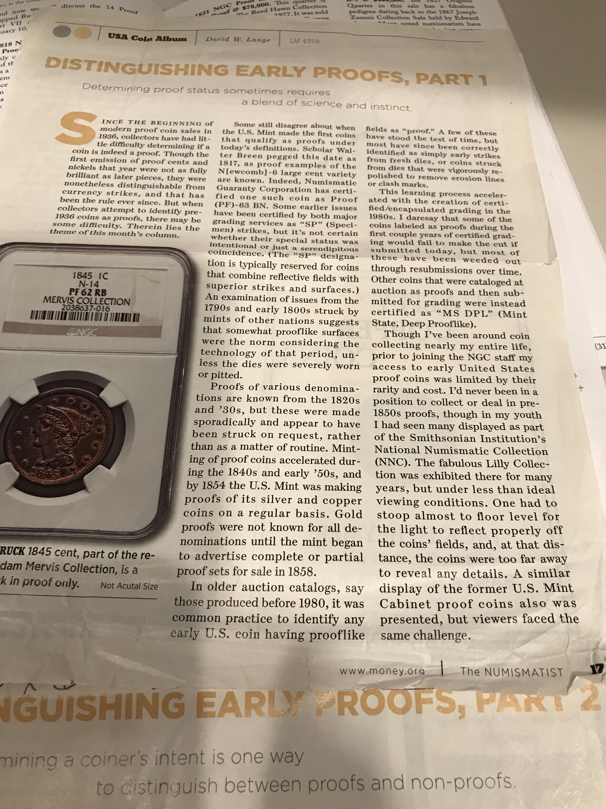
“distinguishing early proofs” David lange
David Lange’s articles in the Numismatist in 1994 titled “Distinguishing Early Proofs” he stated:
“I always emphasize that die diagnostics are the least responsible method of determining Proof status, for the very reason that the same dies may have been used for both editions (Proofs and circulation strikes).
Even proof like issues from the retired dies never have exactly the same surfaces as true Proofs, as the planchets were not prepared for the Proofing process. They lack the proper texture of a proof, which is something that’s almost impossible to describe.”

Slide 15
Greg Reynolds
In February 2008 Greg Reynolds discussed the upcoming Turtle Rock Collection sale of Proof Bust Dimes on coinlink.com.
He stated: “It is not easy to explain the special nature of early Proof coins. After all, these are among the most elusive and fascinating of all U.S. coins, especially the silver and gold Proofs from the 1820’s.”

Slide 16
….Greg Reynolds
In the 1820’s, silver Proofs were typically characterized by poorly struck high points, slightly rough areas, indentations present before striking and other, sometimes hard to explain, imperfections stemming from the manufacturing process.
Even so, true Proofs, from the 1820’s, look dramatically different from the business strikes of the era. The relationships between the design elements and the fields are different and superior. Further, mirror surfaces, certain extra detail, and relatively more elaborate borders, plus other factors, distinguish Proofs from business strikes. It is a difference of kind, not degree.”

Slide 17
Rick montgomery
Rick Montgomery told me at the FUN Show in January 2011 that his criteria for early U.S. Proof coins are:
Quality of Strike
Depth of Mirrors
Thick Rims
Provenance

Slide 18
Jeff Garrett
Jeff Garrett discussed early U.S. Proofs in CoinWeek last November.
In the article ”When Proofs Were New,” a list of all the Proof coins in the Smithsonian Collection from 1818 until 1857 was presented.
This list has been very useful in determining estimated survival numbers for early Proofs.

Slide 19
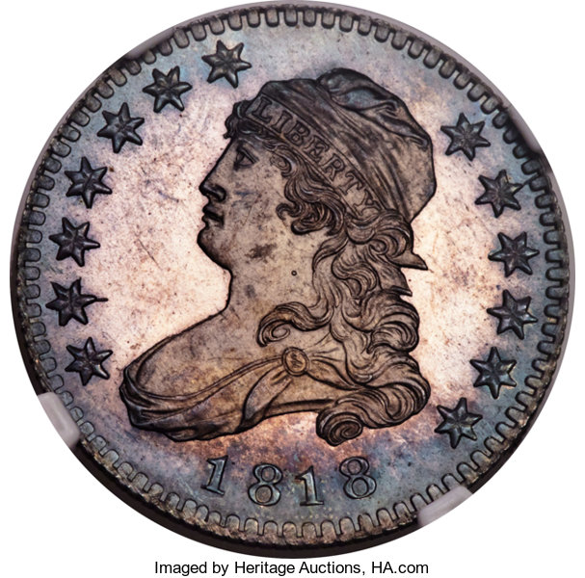
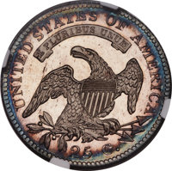
1818 B-8 NGC PROOF 67 cac cleneay, green, newman

Slide 20
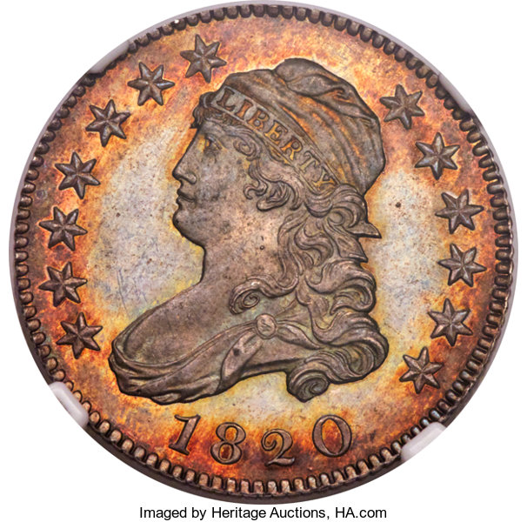
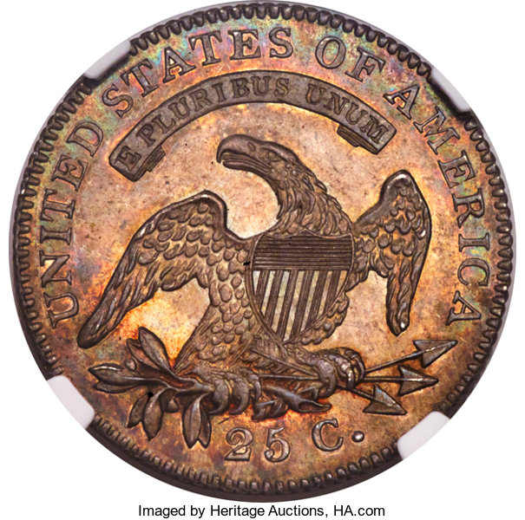
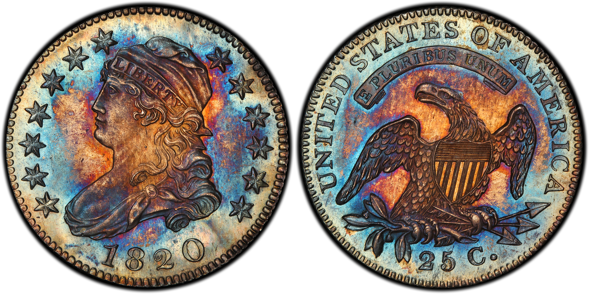
1820 B-1
NGC Proof 64
CAC
PCGS Proof 66
CAC
Pogue

Slide 21
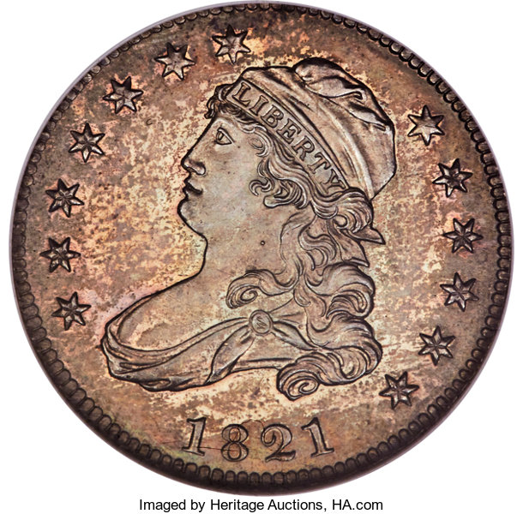
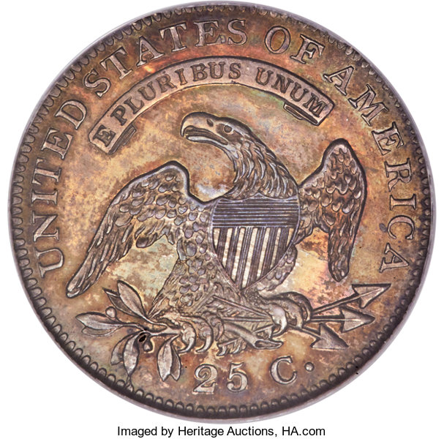
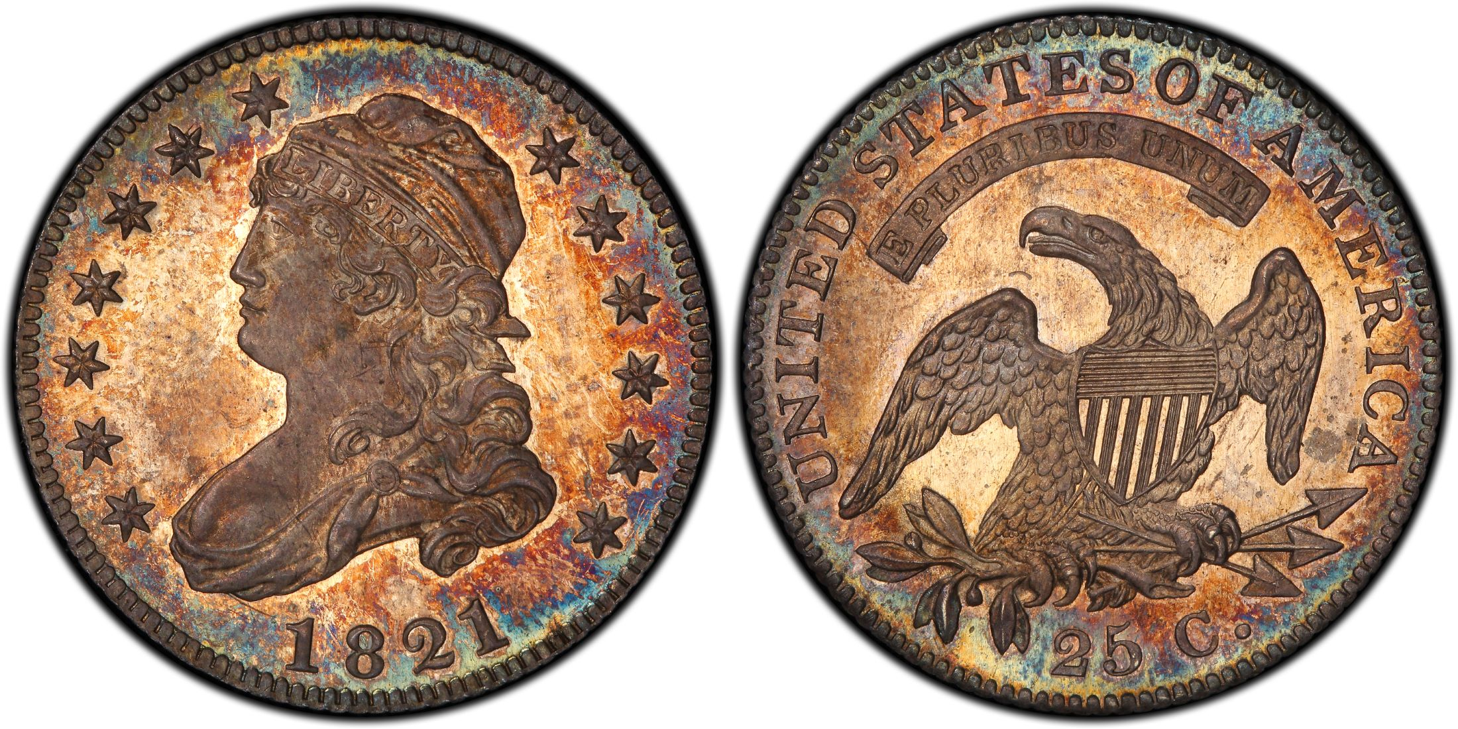
1821
NGC Proof 65
B-4
Hawn/Gardner
PCGS Proof 67
B-5 CAC
Eliasberg/Pogue

Slide 22
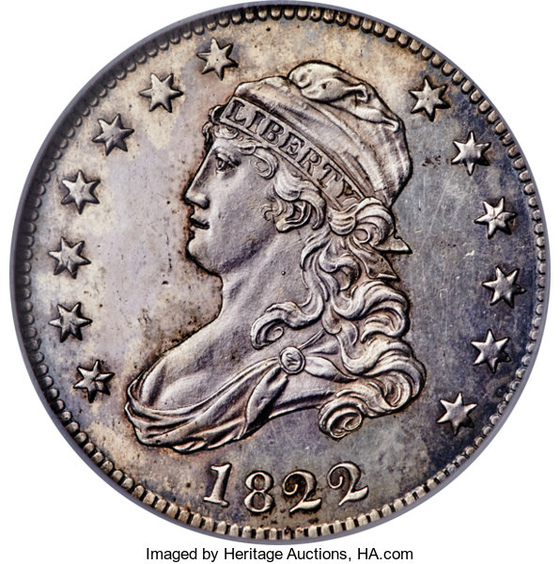
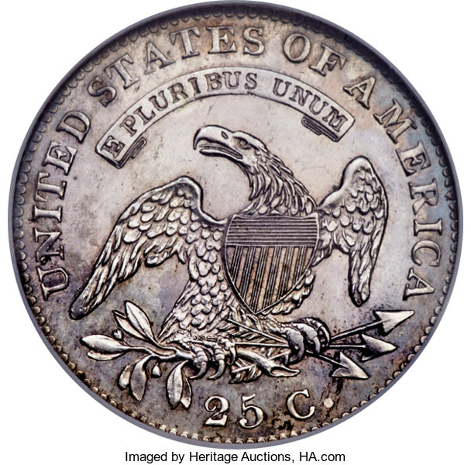
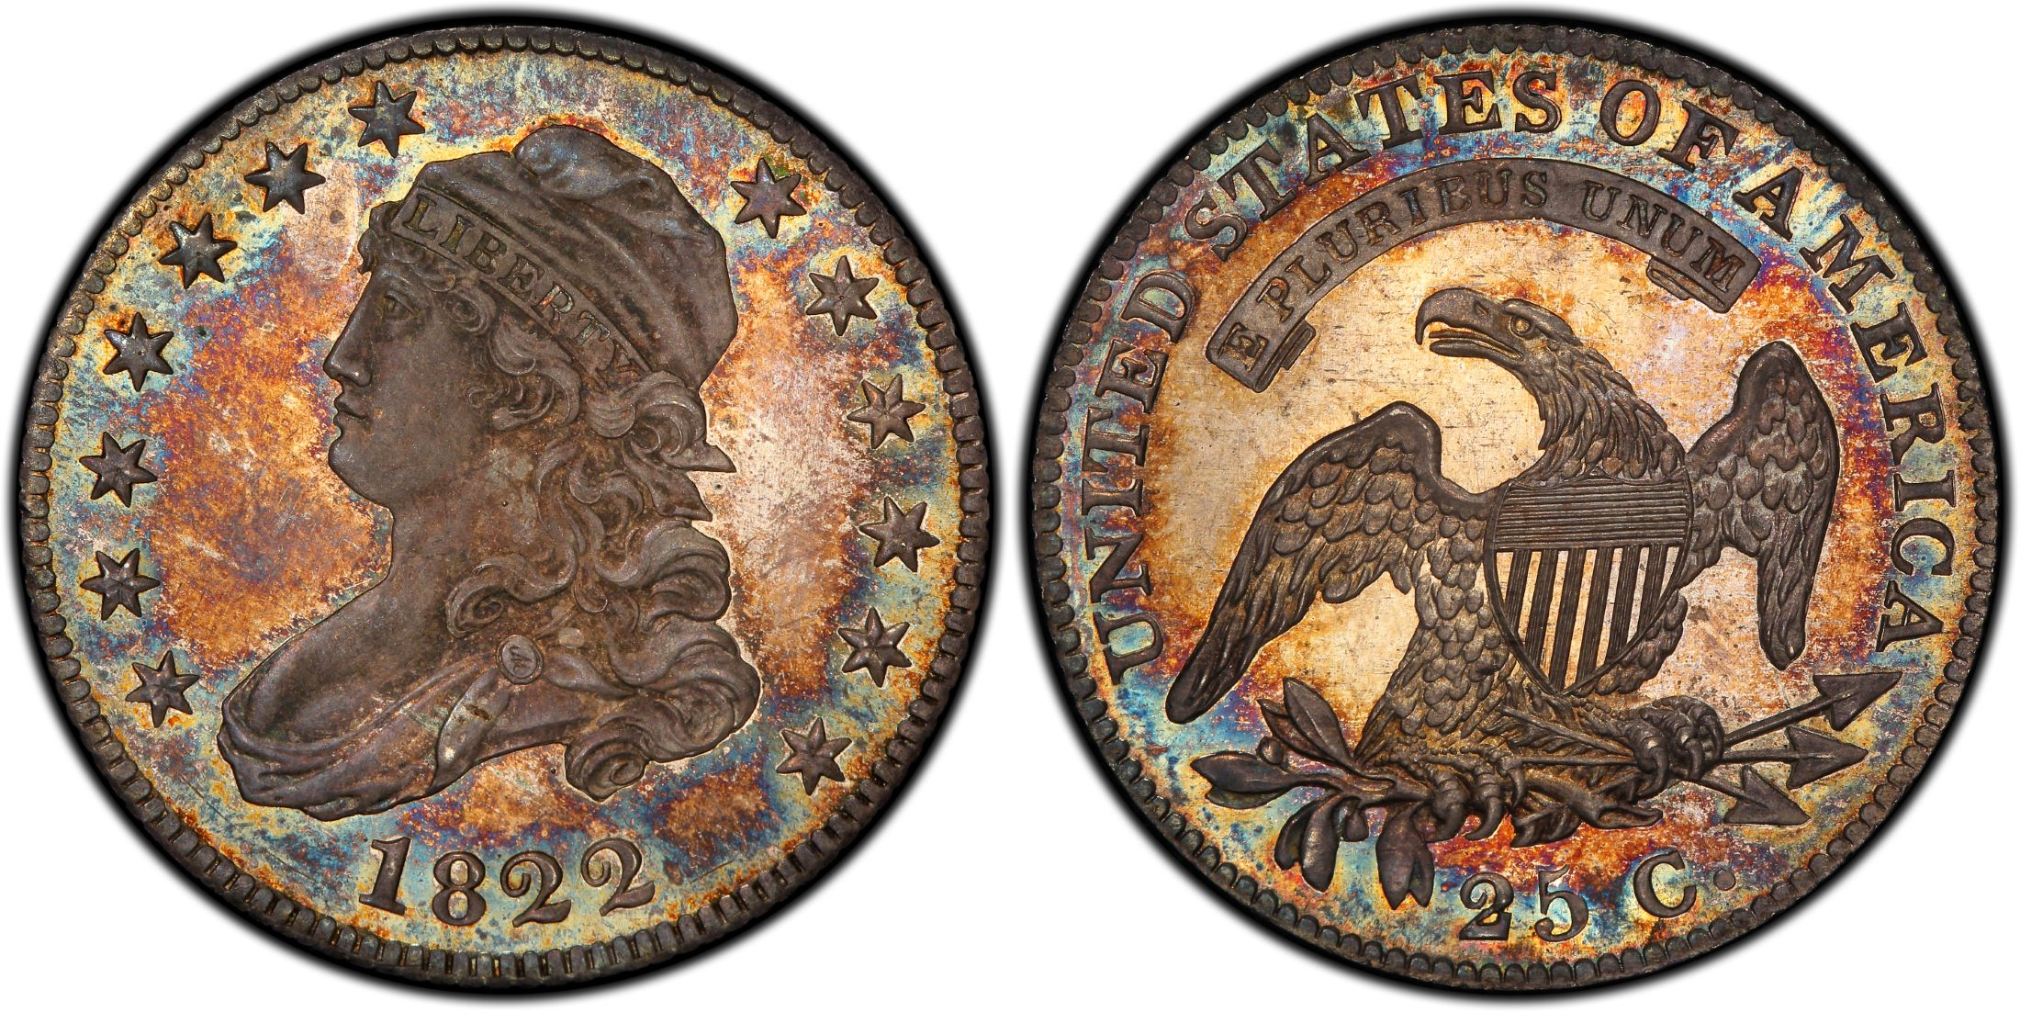
1822 B-1
NGC Proof 63
PCGS Proof 67
CAC
Eliasberg/Pogue

Slide 23
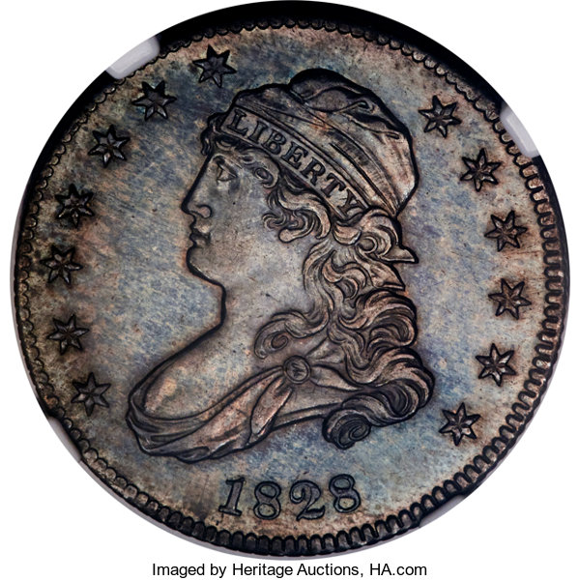
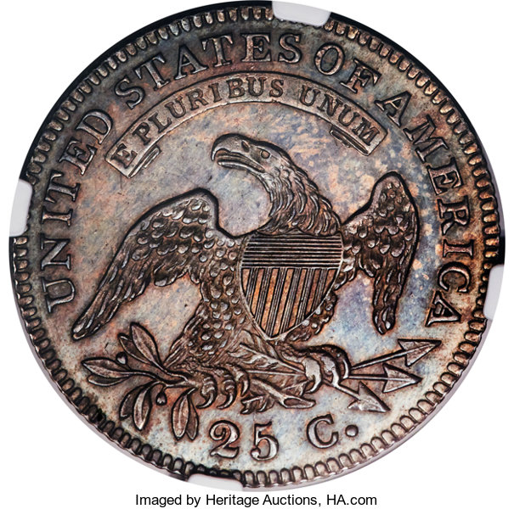
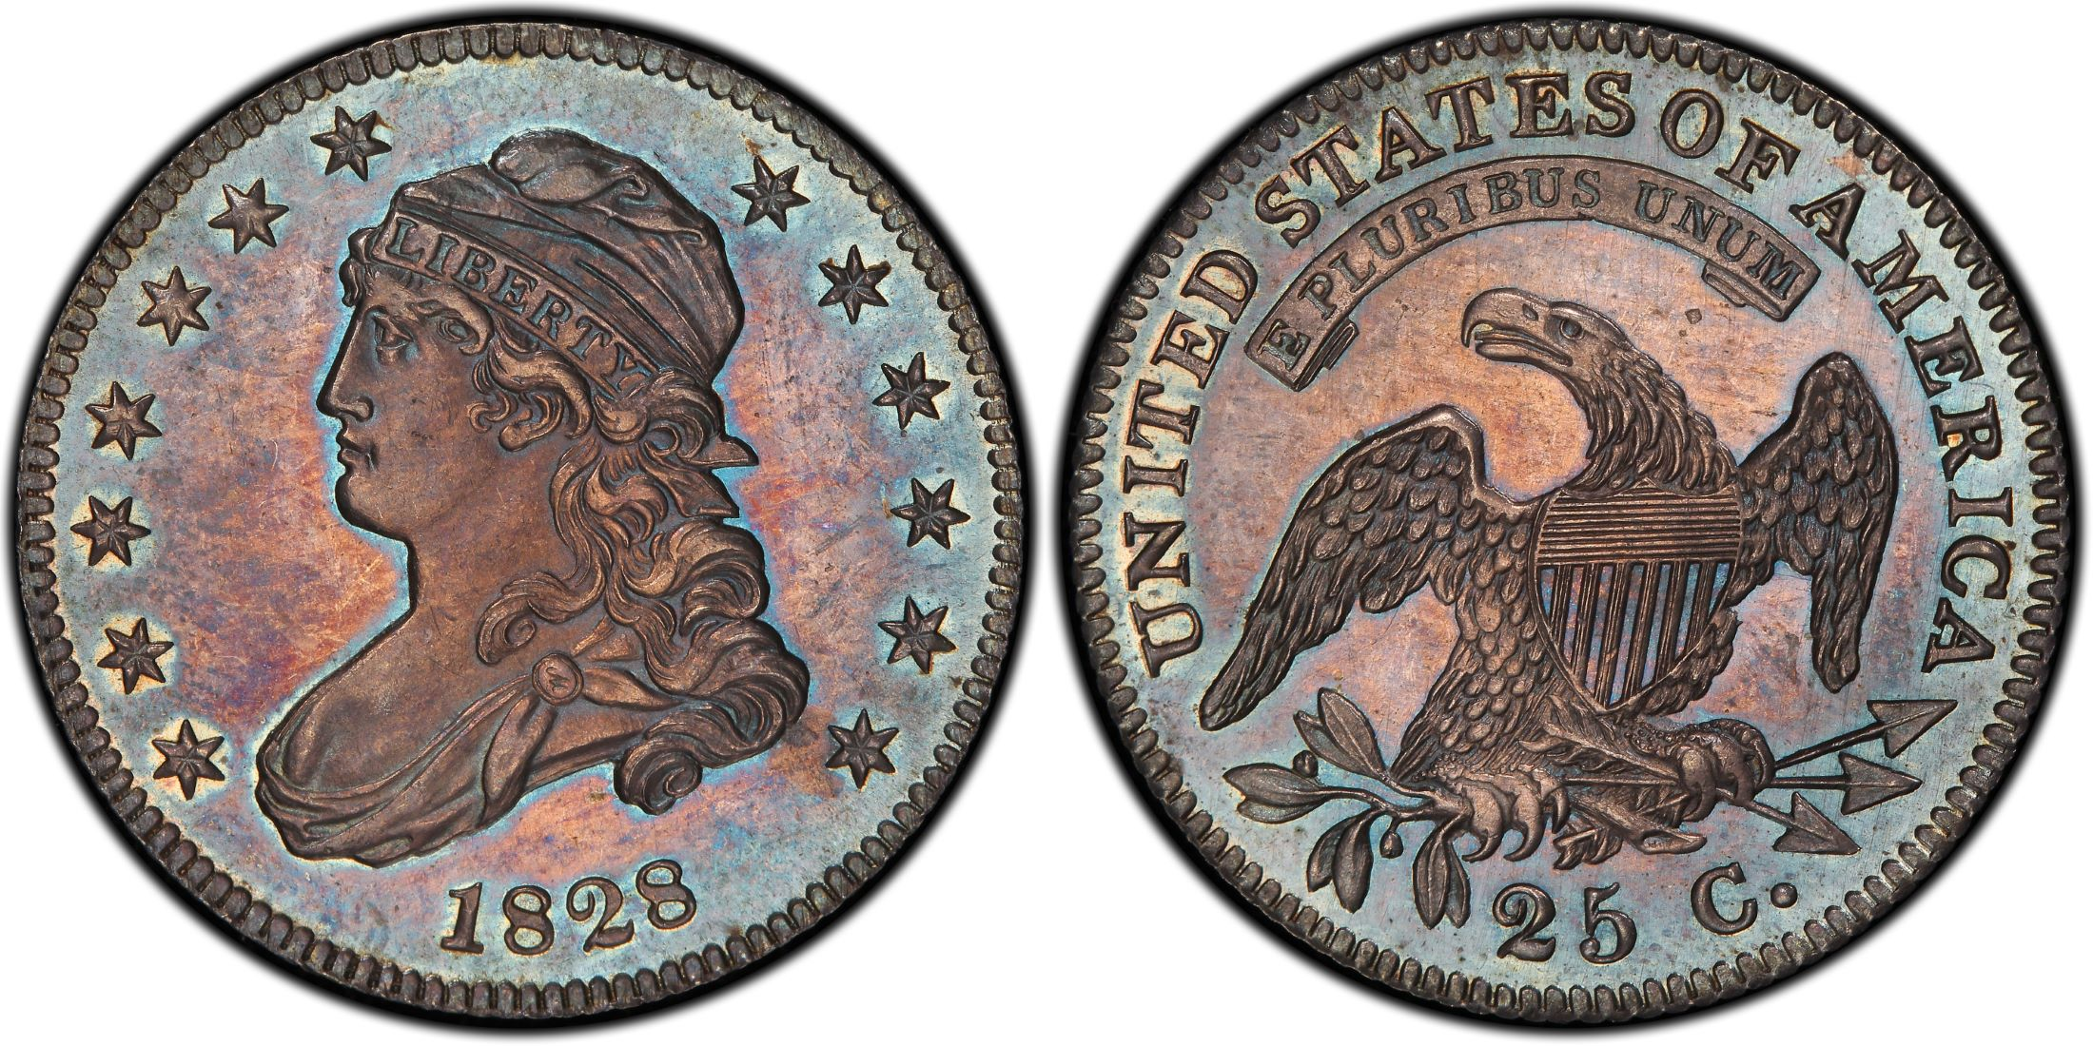
1828
B-4
NGC Proof 66
Pittman
PCGS Proof 65
Parmelee/Gardner

Slide 24
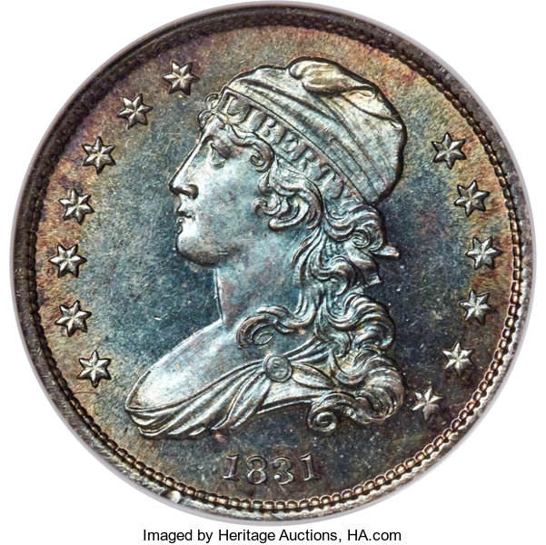
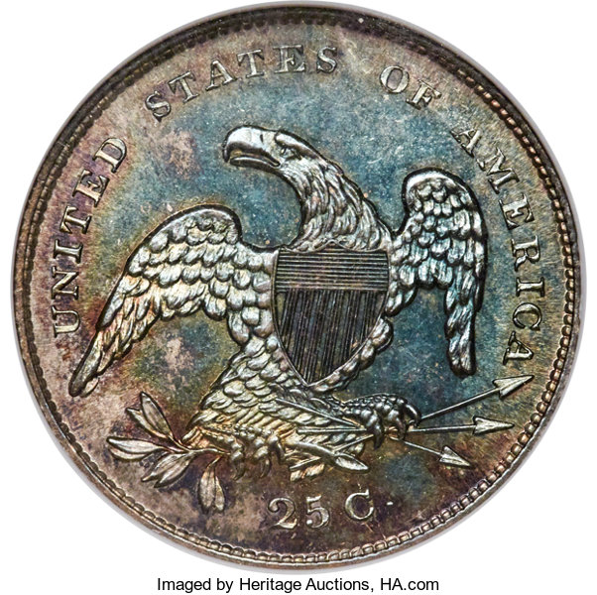
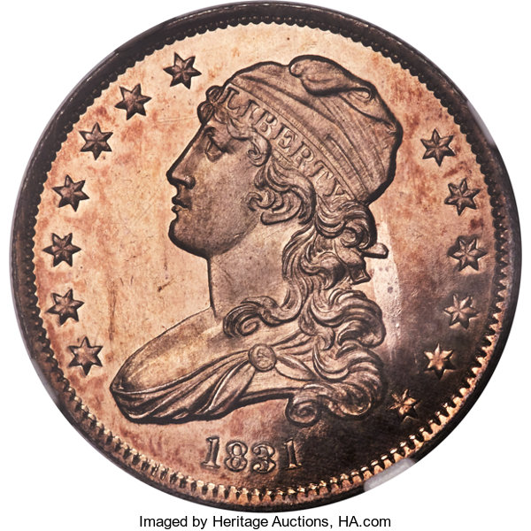
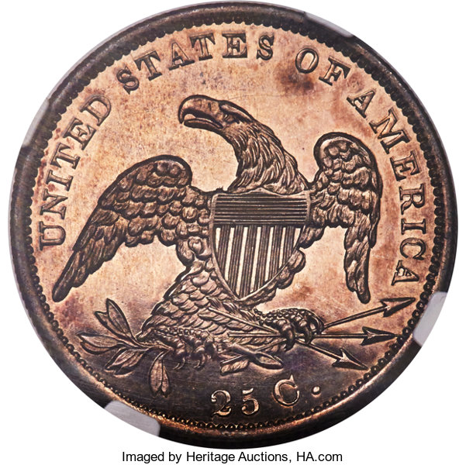
1831
ANACS Proof 64
B-4
NGC Proof 65
Cameo B-5

Slide 25
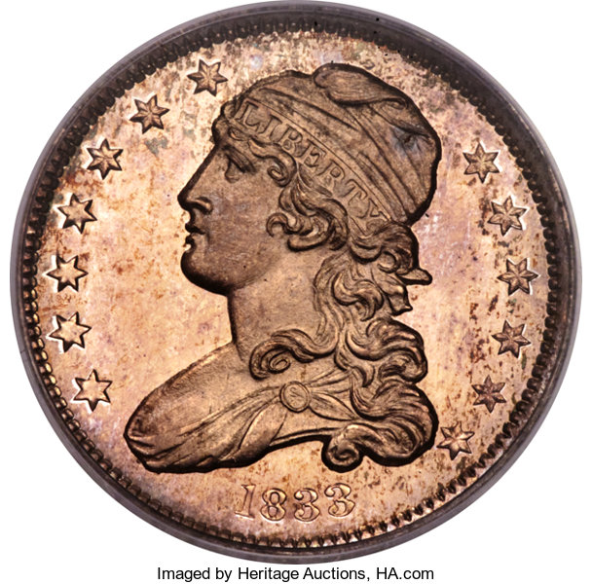
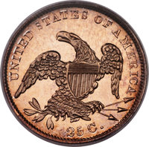
1833 b-1 pcgs proof 65 cameo CAC chalkey

Slide 26
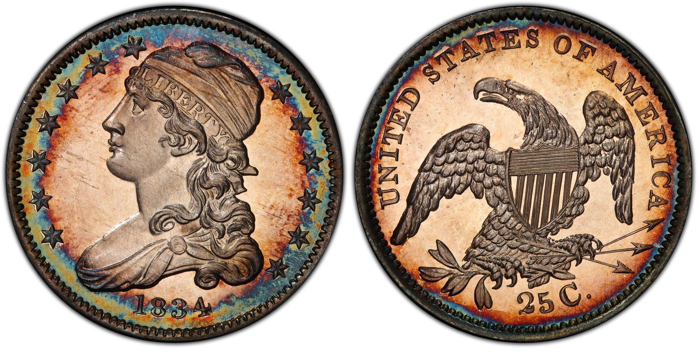
1834 b-2 pcgs proof 66+ cameo cac Newman

Slide 27
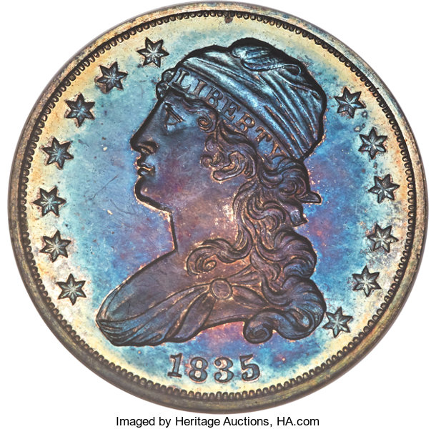
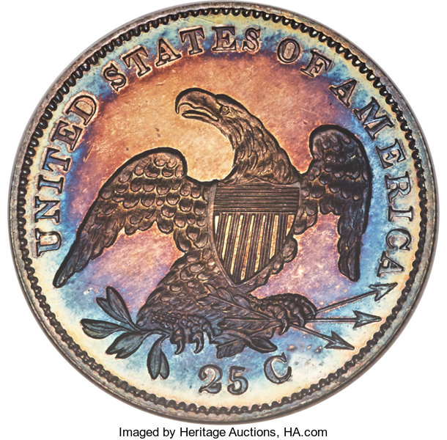
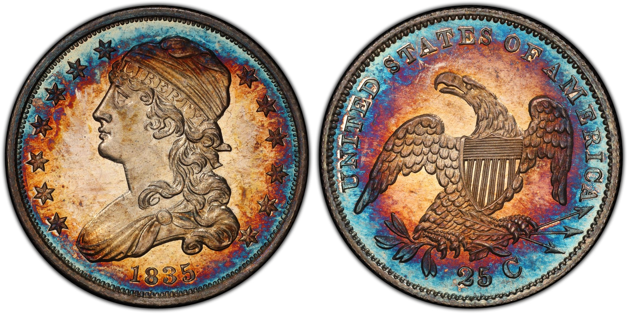
1835
B-7
NGC Proof 64
Gardner
PCGS Proof 66
Cameo
Garrett

Slide 28
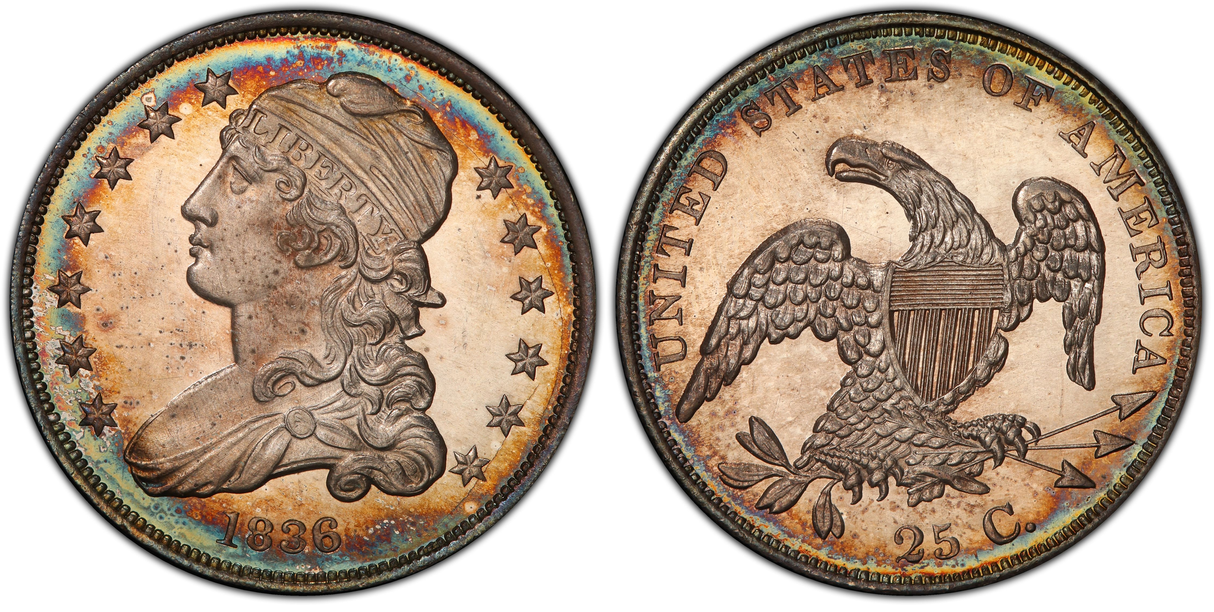
1836 b-2 pcgs proof 66+ cac Eliasberg

Slide 29
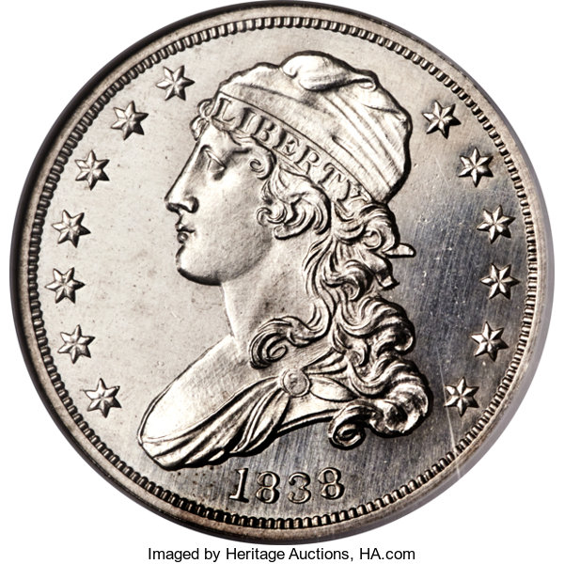
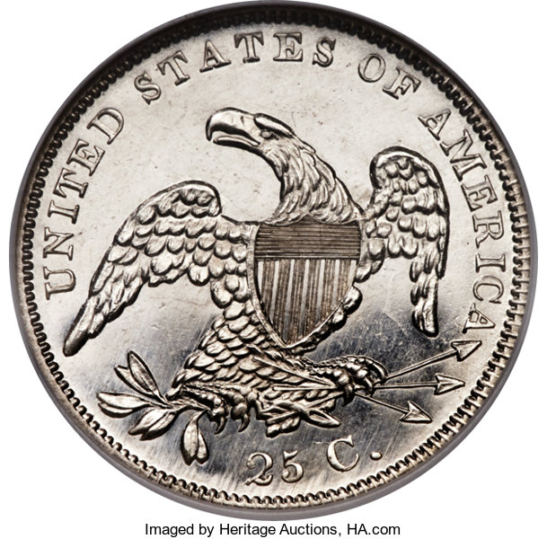
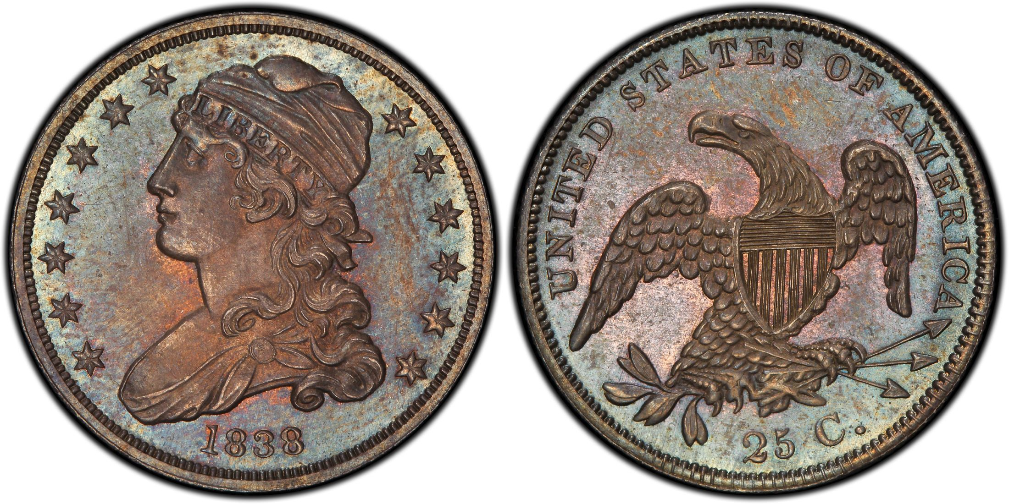
1838
NGC Proof 68*
Cameo B-1
Norweb
PCGS Proof 66
B-1 Pittman

Slide 30
Thanks to
John Dannreuther for definitions in this presentation
David W. Lange articles on ”Distinuishing Early Proofs” in the Numismatist
Greg Reynolds “Turtle Rock Collection” article in coinlink.com
Jeff Garrett “When Proofs Were New” in CoinWeek.com
PCGS CoinFacts for images and population report
My wife Susie for her unlimited patience
Great friend Chris Leumas for teaching me PowerPoint

Slide 31
Heritage Auctions Auction Archives and Photographs
Rick Montgomery’s Proof Criteria
Walter Breen’s “Encyclopedia of United States and Colonial Proof Coins 1722-1989”

Slide 32
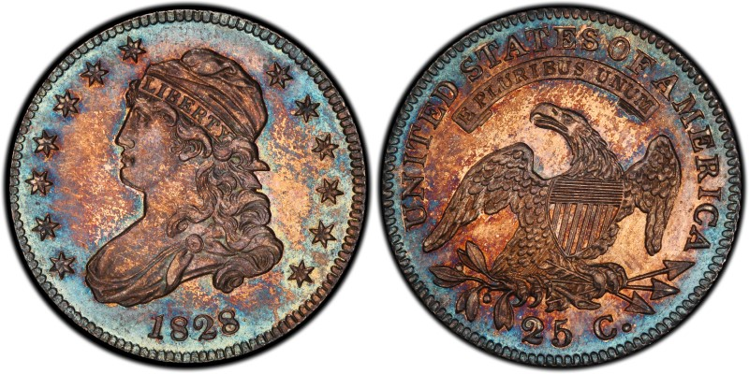
Questions?

Slide 33
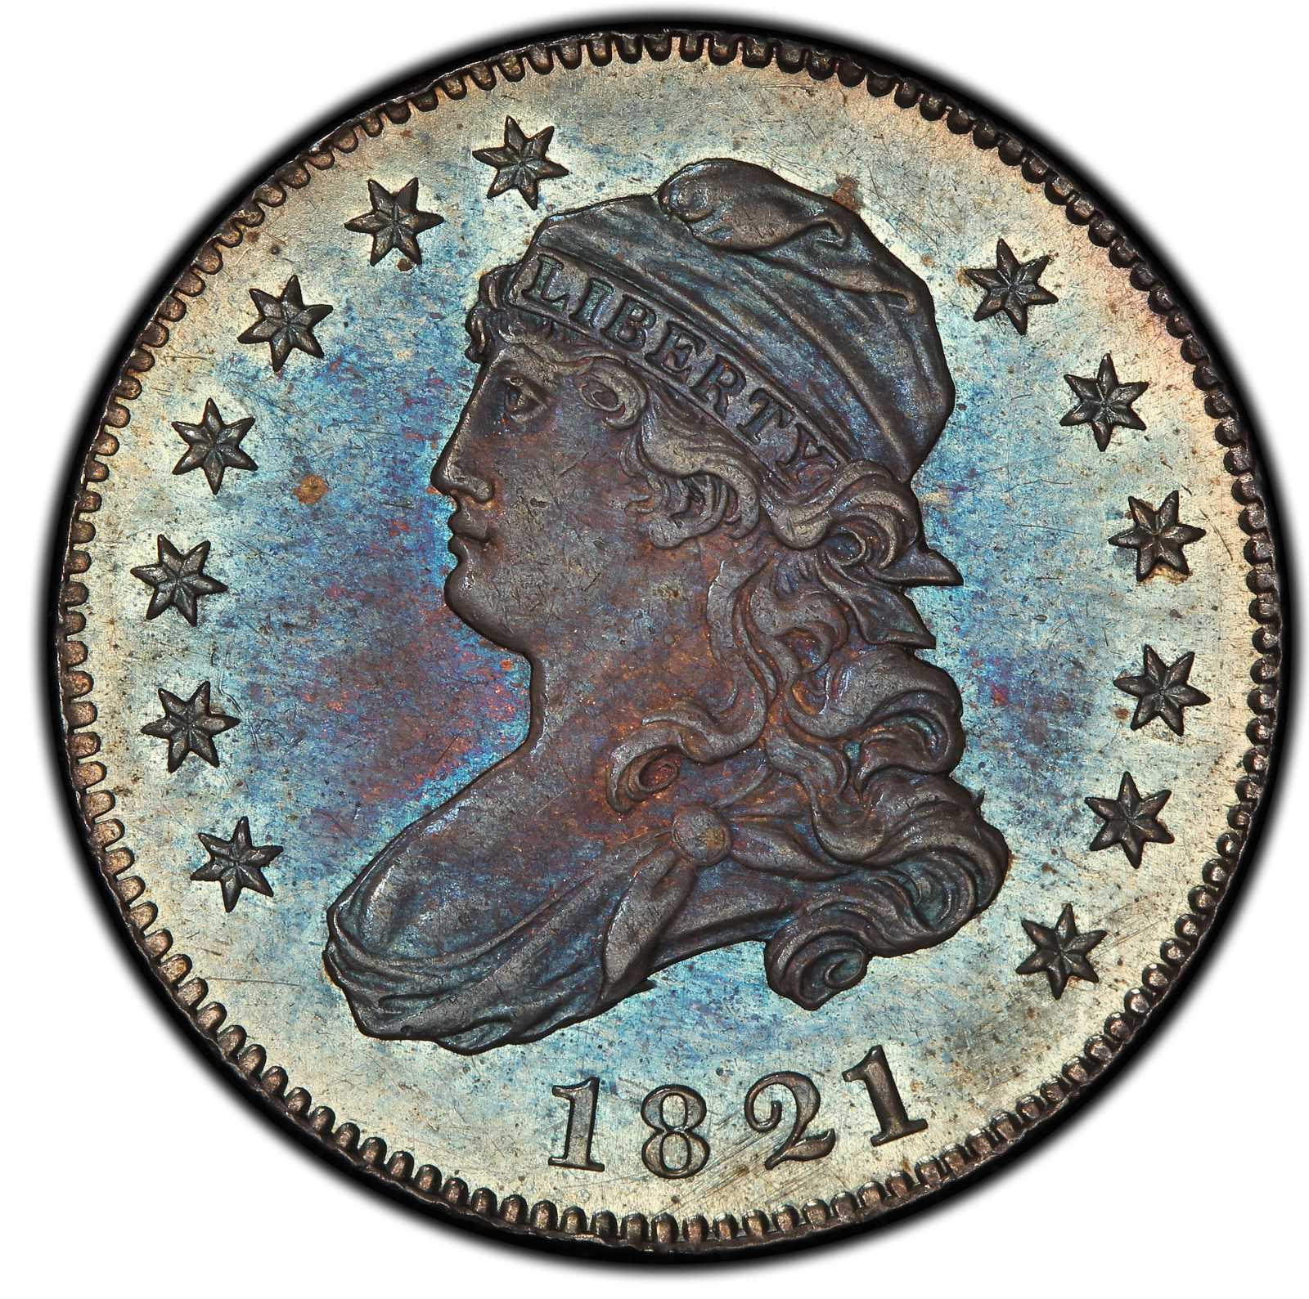
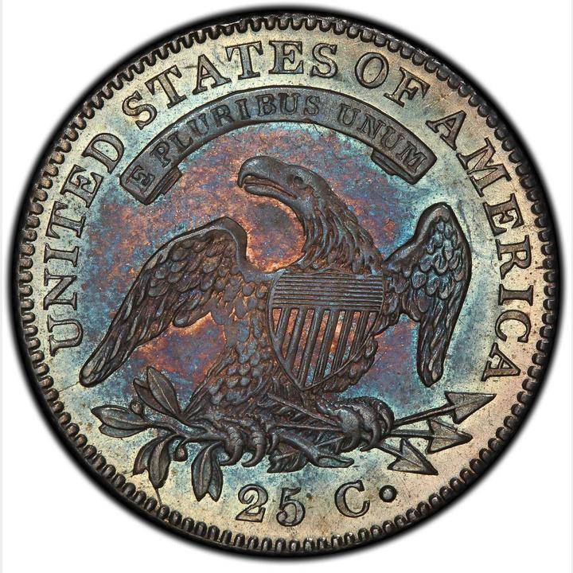
1821 B-6

